Slide 1
Digital Pulse Oximeter
Yifei Du Tianyang Hu Team 8

Slide 2
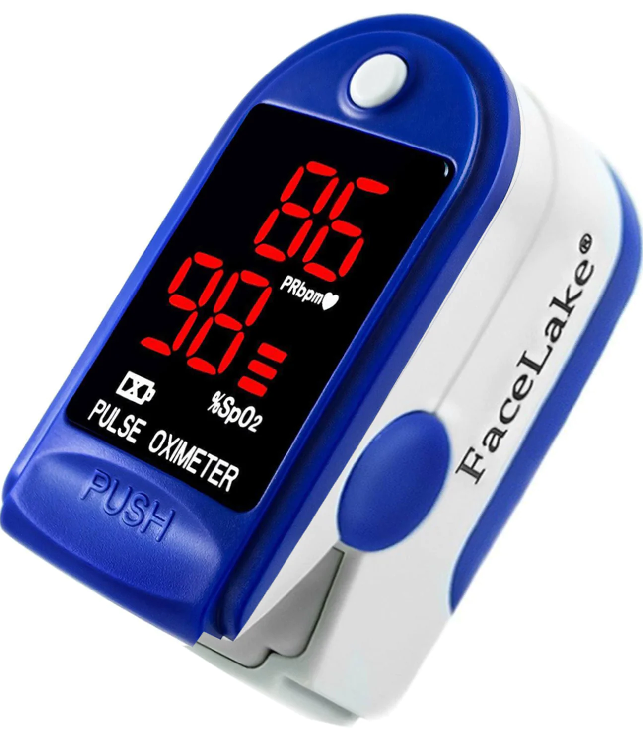
Introduction
Primary Function: Monitoring Blood Oxygen Saturation Level (SpO2)
Importance: Early detection of Hypoxemia.
Advantages:
Non-invasive
Portability
Notes:
Function
A primary function of pulse oximeters is measuring the blood's oxygen saturation level (SpO2). This is vital for monitoring patients with conditions affecting their blood oxygen levels, such as asthma, pneumonia, and COVID-19. Pulse oximeters can detect hypoxemia (low blood oxygen levels) before it becomes dangerous. This early detection is crucial, especially in emergencies, such as monitoring patients with respiratory or cardiovascular conditions. Beyond clinical settings, pulse oximeters are used in fitness and wellness contexts, such as by athletes training at high altitudes or in other specialized conditions to ensure safe and effective training regimes.
Advantage
Non-invasive Monitoring: They provide a non-invasive way to monitor the oxygenation of a patient's hemoglobin. Usually, a sensor is placed on a part with a thin skin layer of the patient's body, such as a fingertip.
Portability and Accessibility: Modern digital pulse oximeters are small, portable, and easy to use, making them accessible not only in hospitals but also in community clinics, ambulances, and home care settings.
Having explored the important role that digital pulse oximeters play in various scenarios, let's take a look at how our product is engineered.

Slide 3
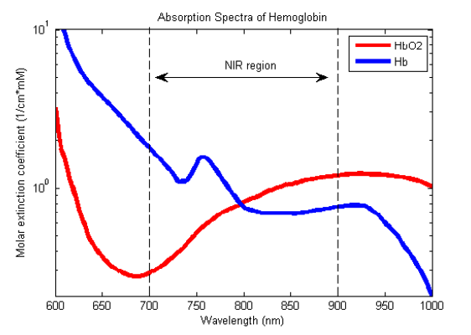


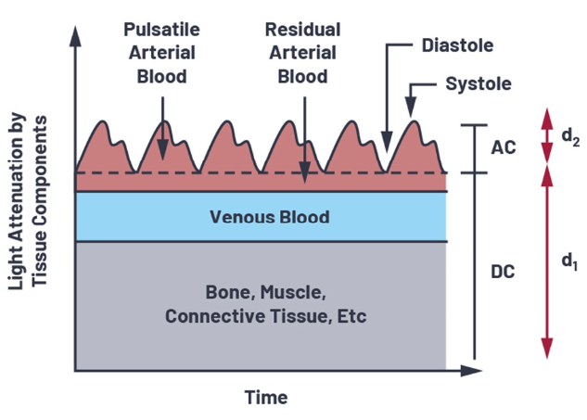


Principle of Operations
SpO2 is defined as the fraction of oxygenated hemoglobin within all hemoglobin.
Compartment Model and Beer’s Law enable the non-invasive Pulse Oximetry
Light Intensity (I) is measured at 2 wavelengths (660 nm and 940 nm) and used to obtain SpO2
Notes:
Having explored the important role that digital pulse oximeters play in various scenarios, let's take a look at how our product is engineered.
The SpO2 is defined as the fraction of oxygenated hemoglobin within all hemoglobin.
When light passes through tissue, it’s components of different wavelength gets attenuated differently. The amount of light intensity change is modeled by Beer’s Law, as shown.
Human’s blood in a finger also attenuates light, and so do the muscles, bones, and skin. Thus, a finger is modeled into several components, where most of the components attenuate a fixed amount of light. as you can see here. However, the volumetric blood flow in the finger changes according to heartbeats and attenuates light periodically. We can thus extract only this periodic attenuation and remove the effect of other components in a finger.
The measured max and min light intensity correspond to diastole and systole and can be converted in to absorption.
Absorptions at 2 wavelengths red and IR enable us to obtain blood oxygen saturation level non-invasively with the formula shown above.

Slide 4
System Design and Schematic
Finger Clip with Integrated LEDs and Photodiodes
Transimpedance Amplifier
I - Amplified V
Bandpass Active Filter
V - Filtered V
MyRio LabVIEW
Filtered V - SpO2
Finger
LED
Diode
Power (15V, 5V, GND)
Notes:
The schematic of our system is structured as below.
A finger clip with 2 LEDs and photodiodes are attached to patient’s finger. The LEDs are lit up and photodiodes convert incident light to currents.
The microamp-level currents are amplified and converted to voltages through the transimpedance amplifier circuit.
A bandpass filter is used to further amplify signal and filter the low-frequency signal drift plus the high-frequency powerline noise at the same time.
The signal is fed into the labview program to be furtherly filtered and analyzed to obtain the heartrate and blood oxygen saturation level.

Slide 5


Implementation - Finger Clip
Finger Clip with Integrated LEDs and Photodiodes
Finger
LED
Diode
Notes:
Here are the implementations of our design, details can be found in our design notes.

Slide 6
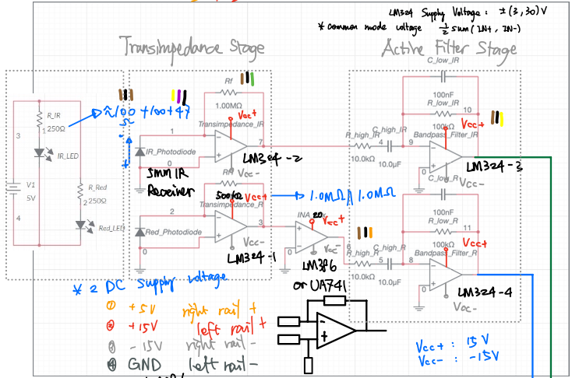
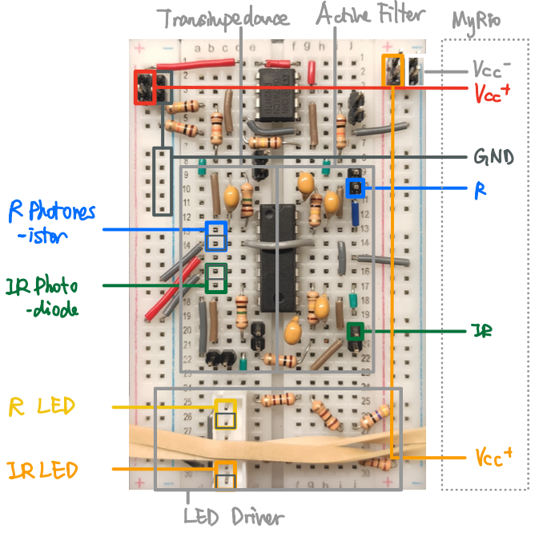
Implementation - Circuits
Transimpedance Amplifier
I - Amplified V
Bandpass Active Filter
V - Filtered V

Slide 7
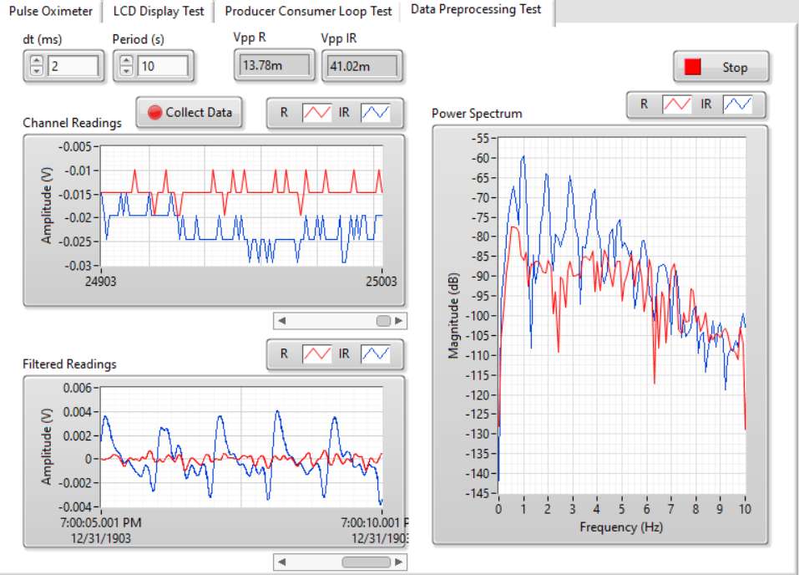
Implementation - LabVIEW
Frequency of Largest Power:
~1 Hz = 60 bpm
Raw Signal
Digitally Filtered Signal
Clear Heartbeat Waveform from IR Channel

Slide 8
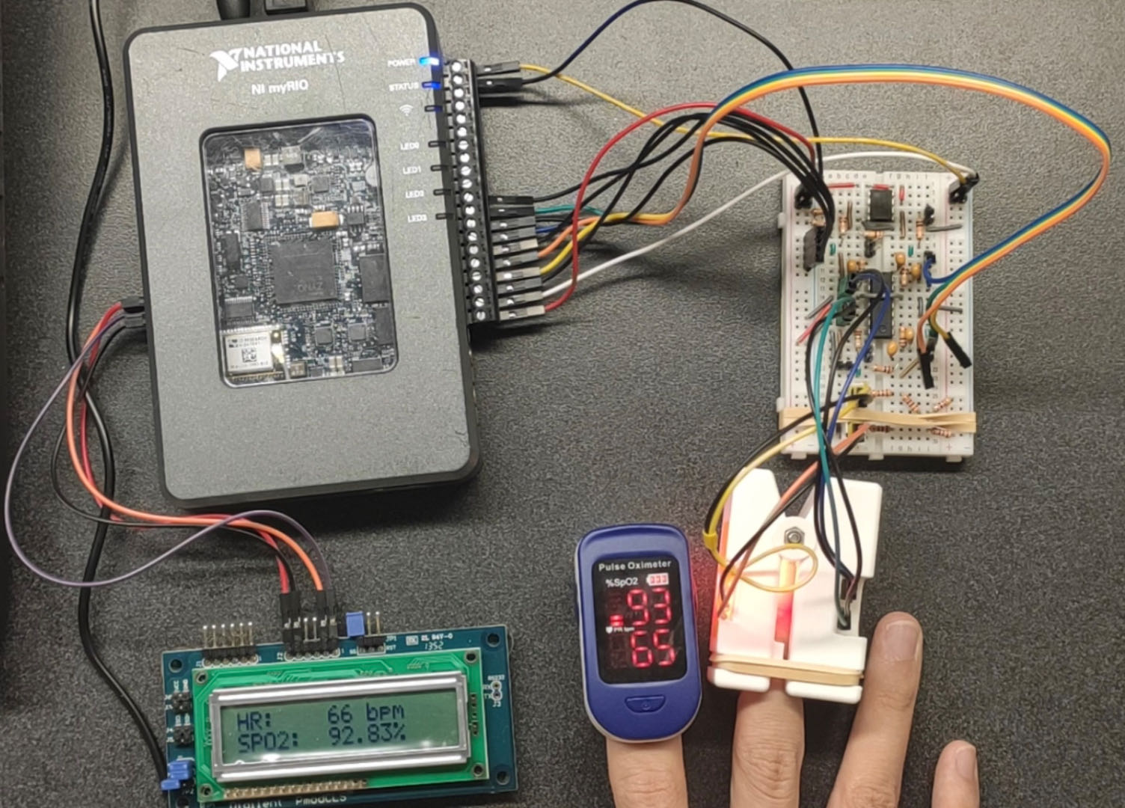
System Overview
Notes:
Here is a picture of our system assembled. The outputs of our system is compared with a commercial device.

Slide 9


Future Improvement
Transmit data remotely
Portable Design
Better signal filtering
Notes:
To make our design function as other commercial products, we can make the following improvements in the future.
First, we can make our digital pulse oximeters transmit data remotely, aiding in remote patient monitoring, which became particularly important during the COVID-19 pandemic.
Second, we can make the product more compact and portable using integrated circuits.
Finally, we can modify the circuit to get better-filtered signals, or use electronic parts with less noise to make the measurements more accurate and stable.

